Slide 1
Reproducing Kernel Hilbert Spaces (RKHS)
Shao-Hsuan Wang

Slide 2
References:
2019. Huang S. Y. Introduction to Kernel Machines (at Math, NCKU)
2019. Wainwright M. J. High-Dimensional Statistics: A Non-Asymptotic Viewpoint (Chapter 12). Cambridge.

Slide 3
Basics of Hilbert spaces
Reproducing kernel Hilbert spaces
Riesz Representation Theorem
Constructing an RKHS
Gaussian measure on a Hilbert space
A generalized eigen-decomposition - Mercer’s Theorem
Outline

Slide 4
Basics of Hilbert spaces

Slide 5

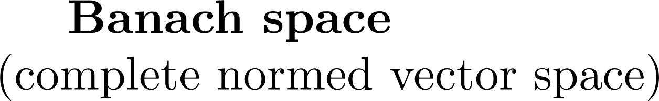
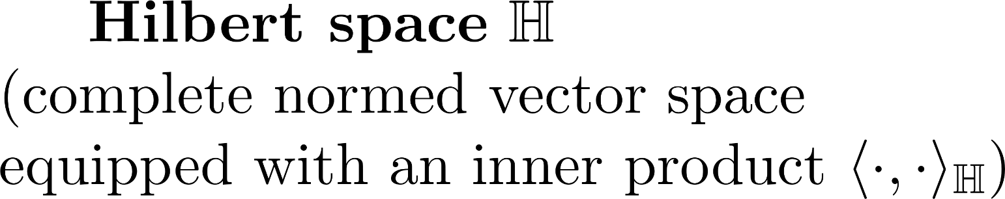

Slide 6
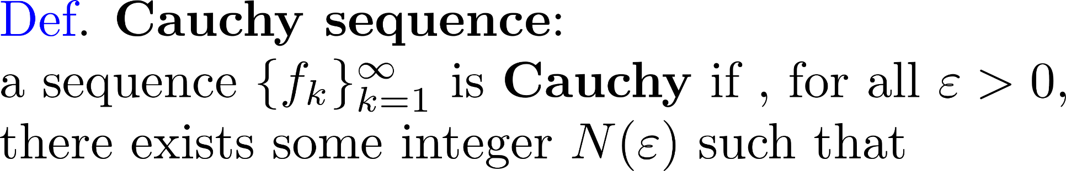

Slide 7
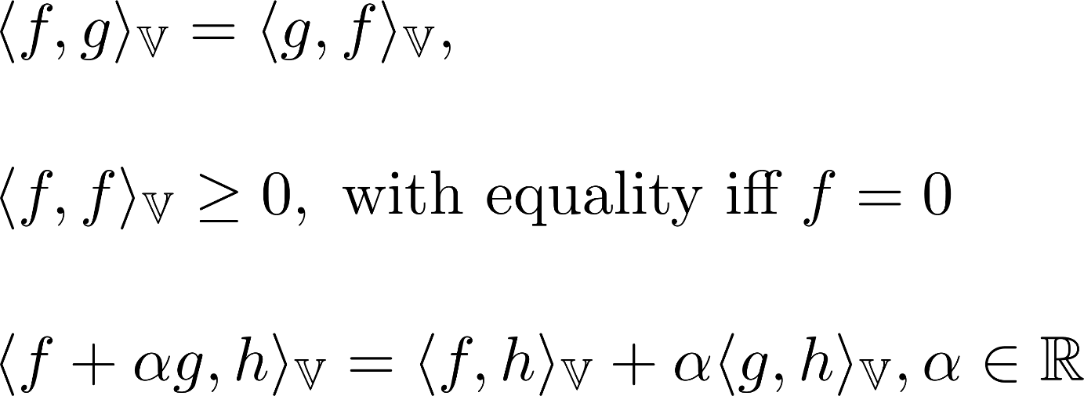

Slide 8
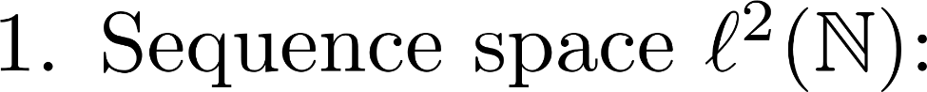
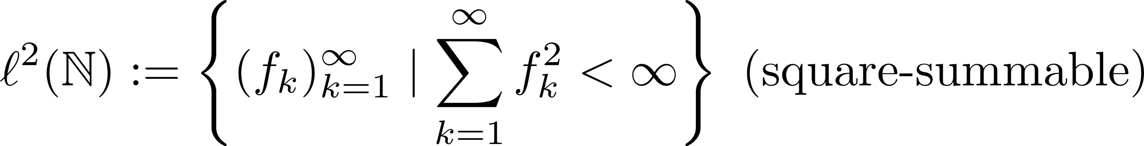
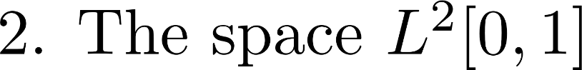

Slide 9
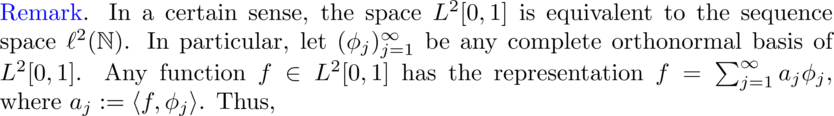
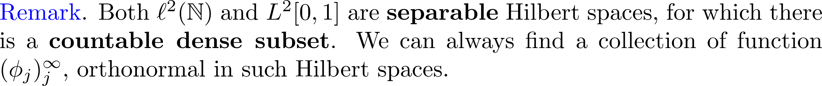

Slide 10
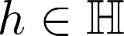
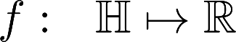
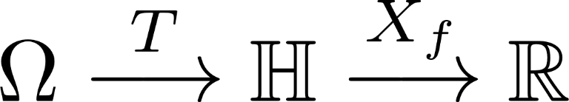

Slide 11
Reproducing kernel Hilbert spaces (RKHS)

Slide 13
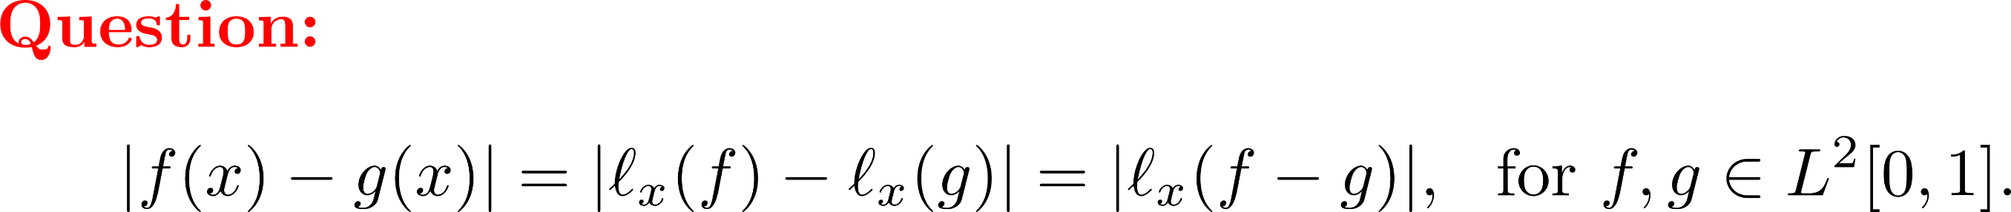

Slide 15
Goal: Hilbert space with

Slide 16
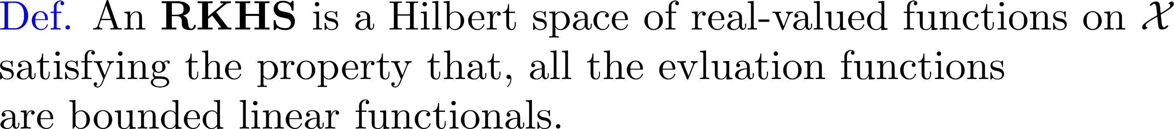

Slide 17
Riesz Representation Theorem

Slide 19
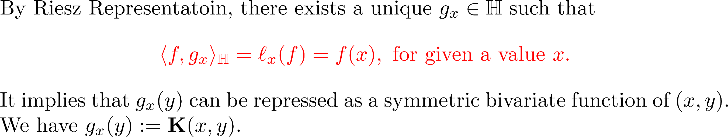

Slide 20


Goal: Hilbert space with

Slide 21
Constructing an RKHS

Slide 22
1. Positive semidefinite (PSD) kernel functions 2. Constructing an RKHS from a kernel

Slide 23
1. Positive semidefinite (PSD) kernel functions

Slide 24
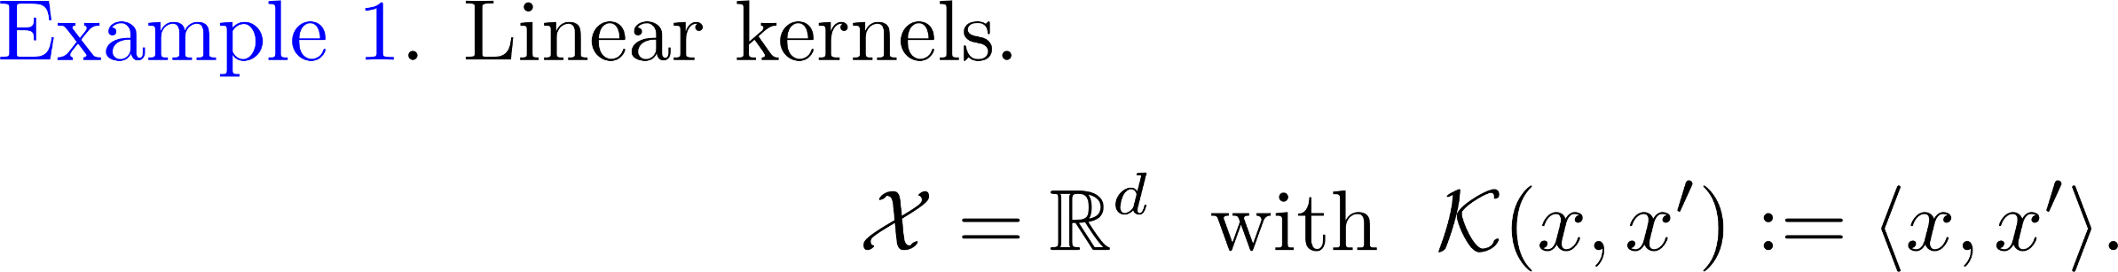
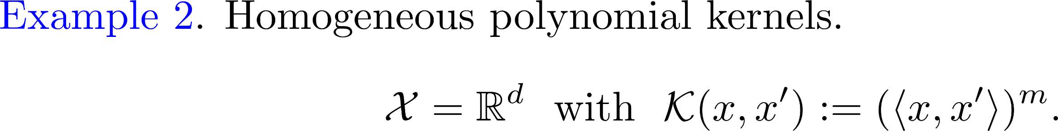

Slide 25
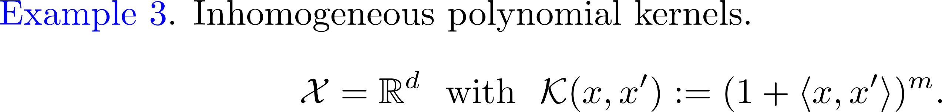
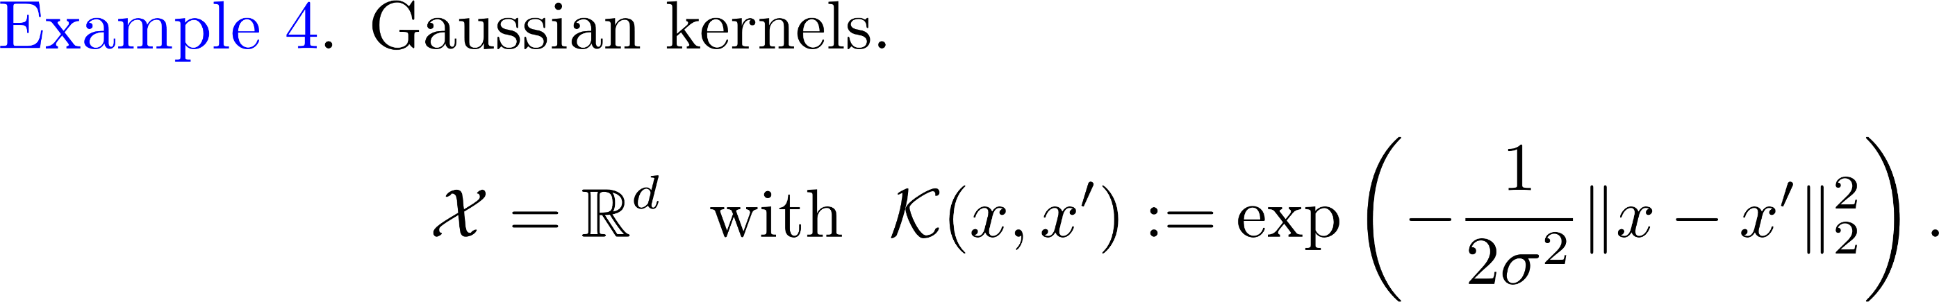

Slide 26
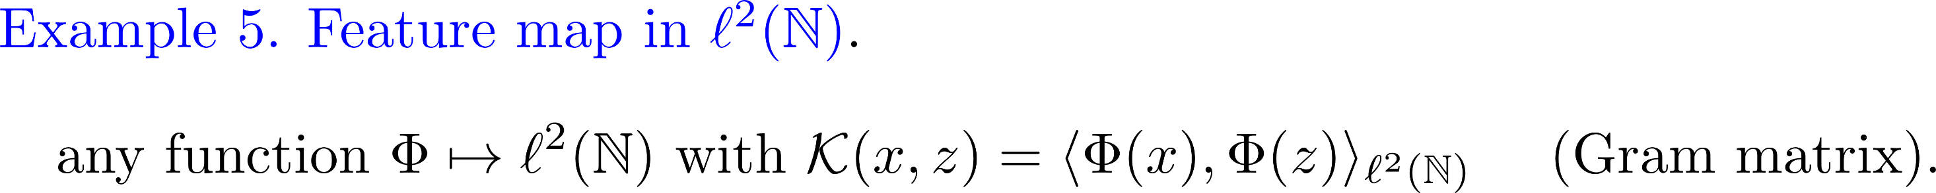
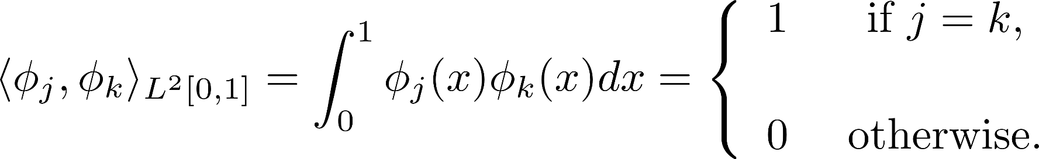

Slide 27


Slide 30
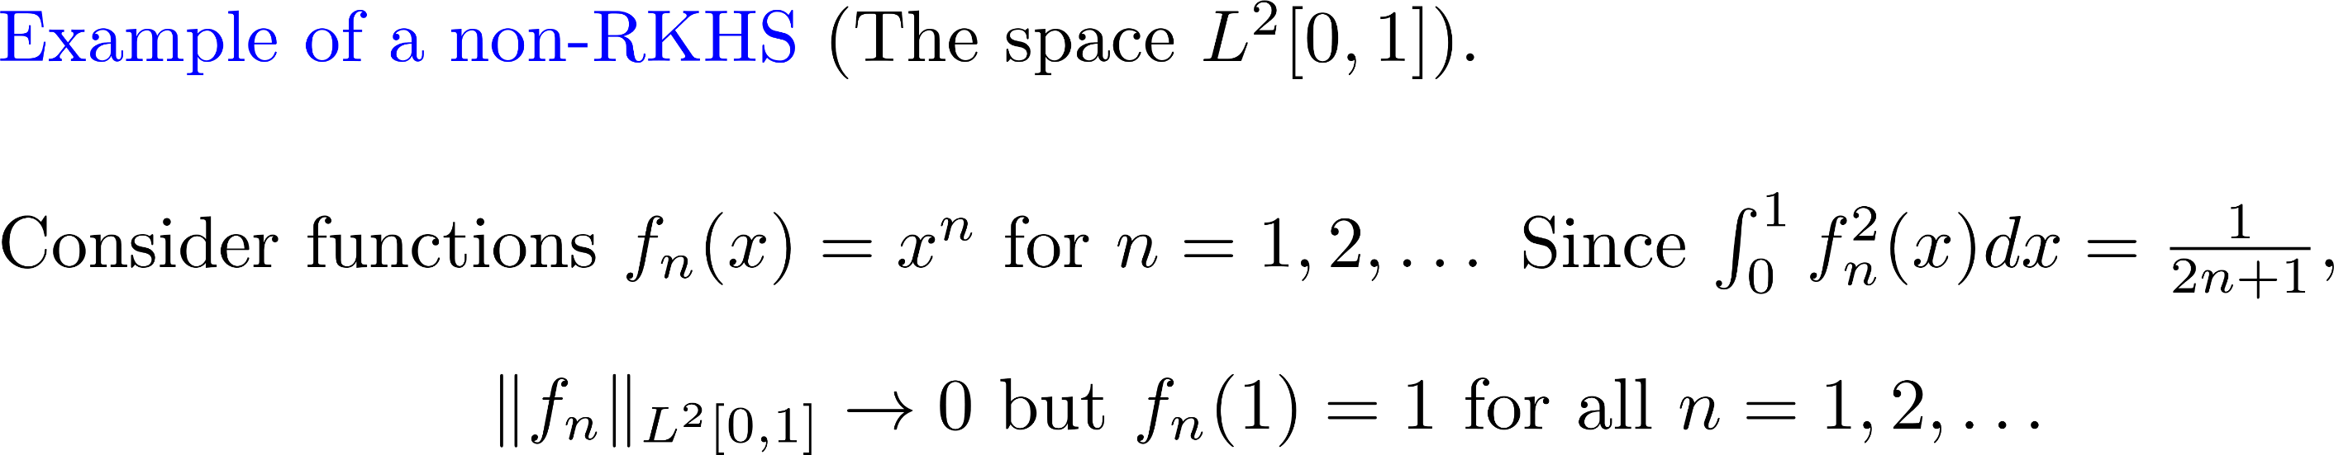

Slide 31
Gaussian measure on a Hilbert space

Slide 32
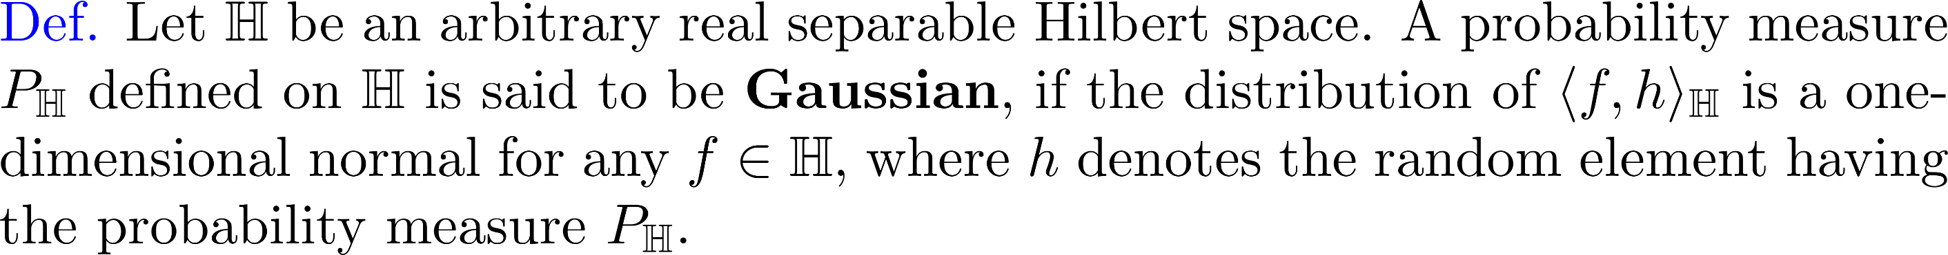
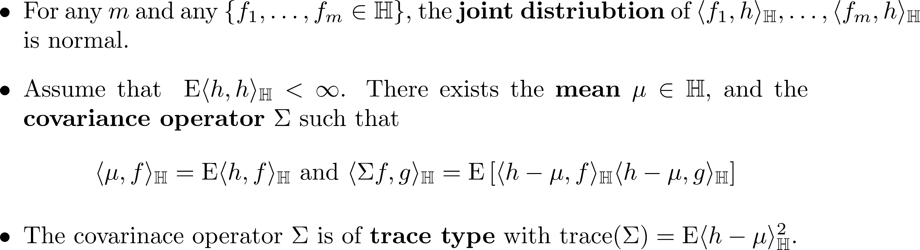

Slide 33
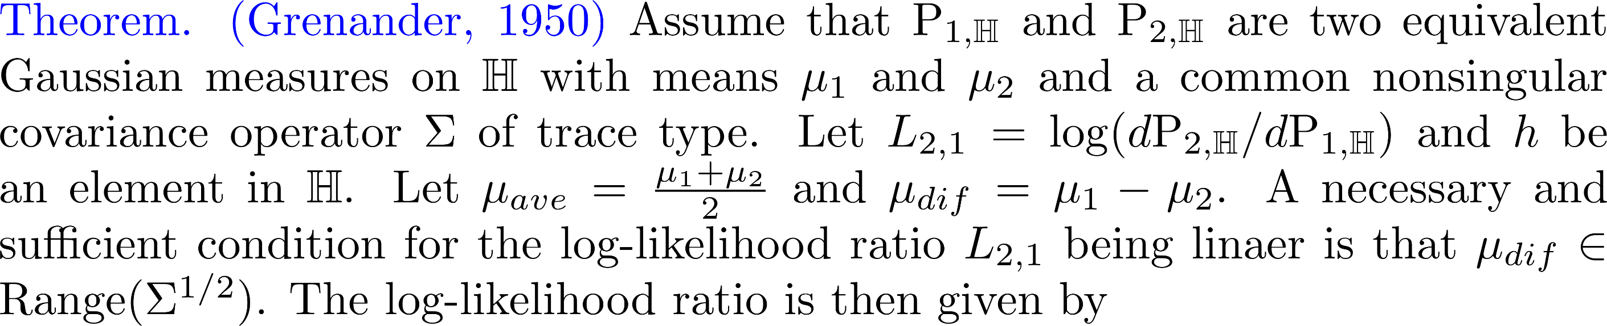

Slide 34
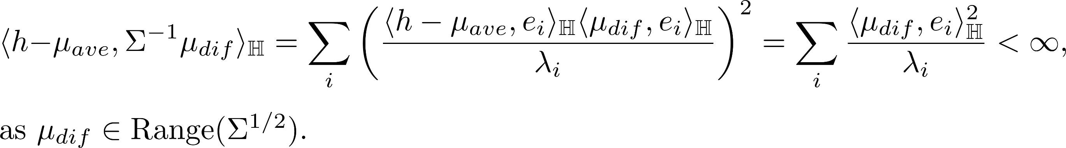

Slide 35
A generalized eigen-decomposition - Mercer’s Theorem

Slide 36
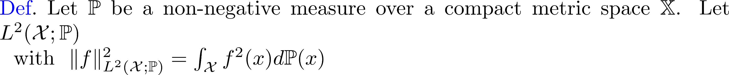
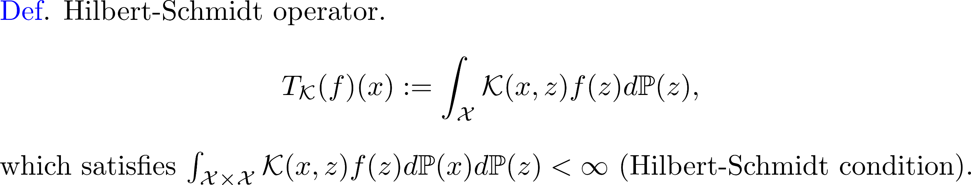

Slide 37
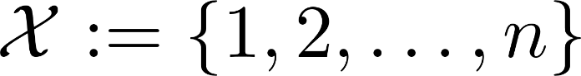
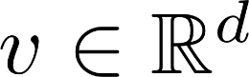
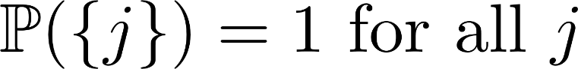
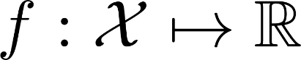
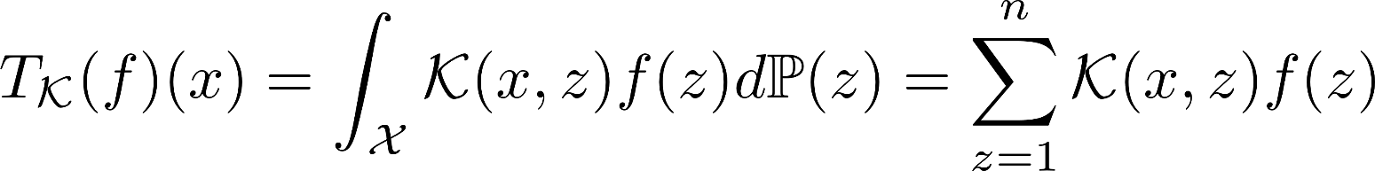



Slide 38
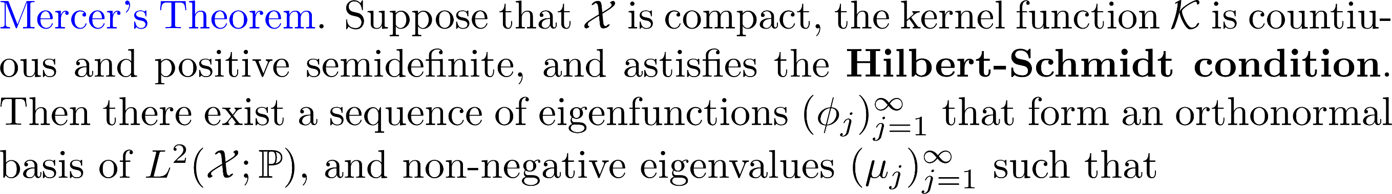
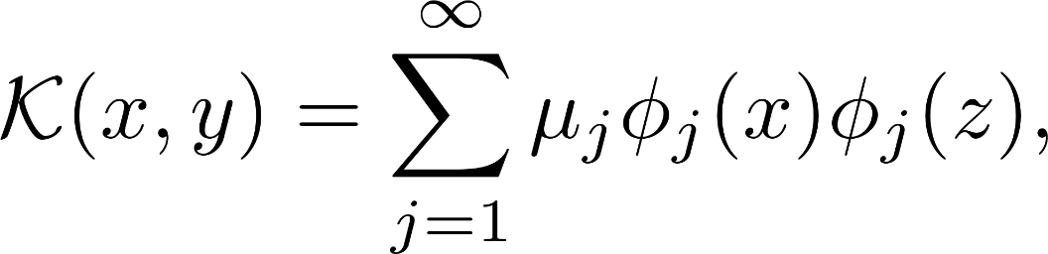

Slide 39
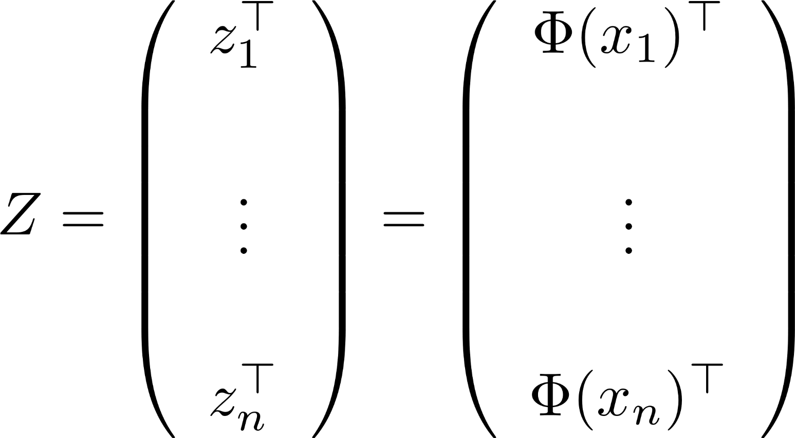

Slide 40



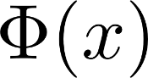

Slide 41
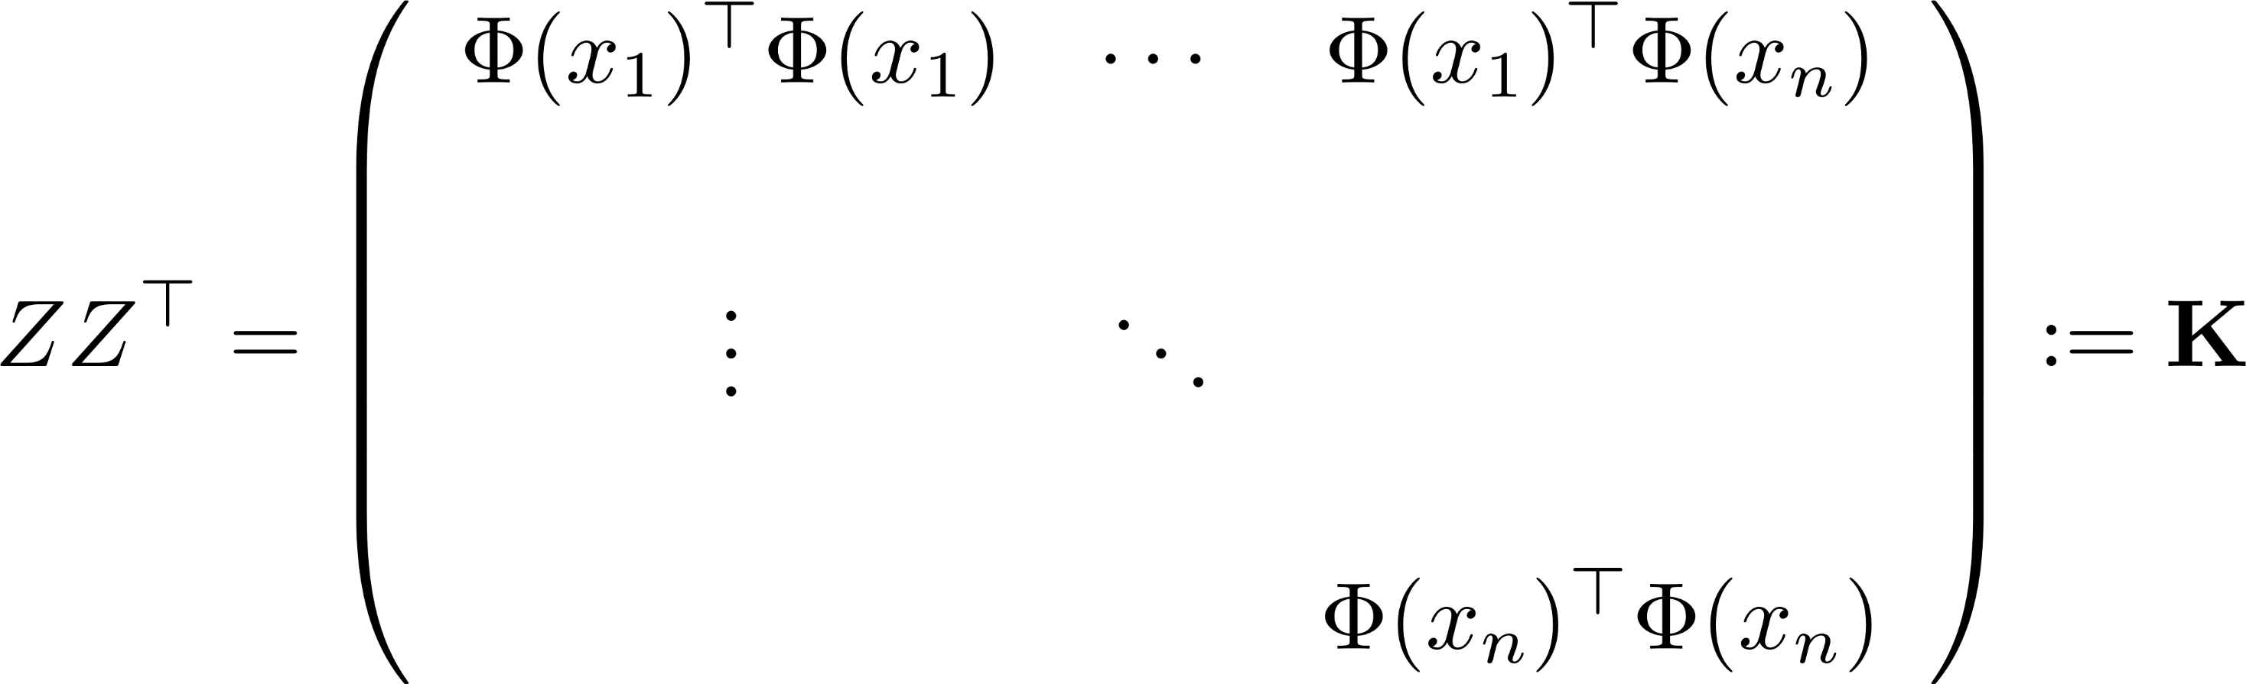
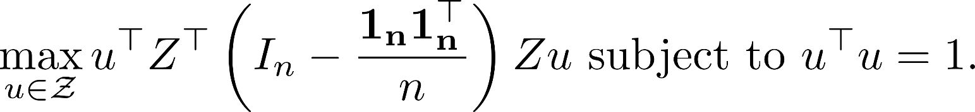

Slide 42
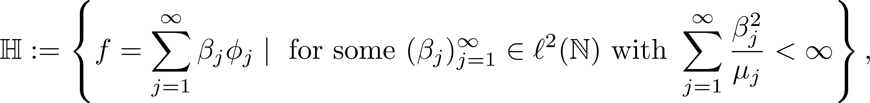
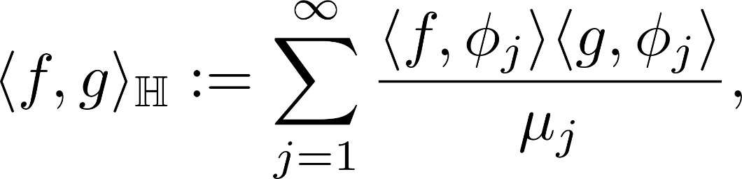

Slide 43
